Slide 1
Messaging in Azure
Azure Service Bus
Valentyn Radchuk
C# Developer @ Cogniance

Slide 2
Agenda
Service Bus overview
Service Bus in Microsoft Azure
Queues and Topics
Azure API for Service Bus

Slide 3
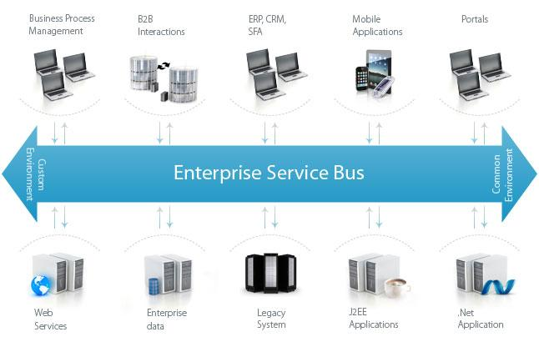
What is Service Bus?
Service Bus - is an architecture model for designing and implementing communication between mutually interacting software applications

Slide 4
Service Bus Duties
Service Bus is a single point of interaction between system components.
Main duties of a Service Bus:
Buffer and deliver messages
Monitor messages
Prioritize and schedule messages
Route messages

Slide 5
What is Azure Service Bus?
Windows Azure Service Bus
Queue
Topic / Subscription
Relay
Site
Mobile App
Service
Publisher
Azure Service Bus (ASB) - is a generic, cloud-based messaging system for connecting just about anything—applications, services, and devices—wherever they are.
ASB - provides a hosted, secure, and widely available infrastructure for widespread communication, large-scale event distribution, naming, and service publishing.

Slide 6
Kinds of Azure Service Bus
Azure Service Bus might be used in two ways:
Brokered bus (async messaging)
stores messages
sends messages when consumer is ready to read them
uses queues, topics and subscription
Relayed bus (sync messaging)
re-translates messages immediately
does not store messages

Slide 7
Brokered Service Bus
Brokered messaging model includes following components:
Queues - store messages until demanded
Topics - behave like a Queue but allow to create subscriptions. Each subscription receives own copy of a message.
Event hubs (implementing publish/subscribe messaging model)

Slide 8
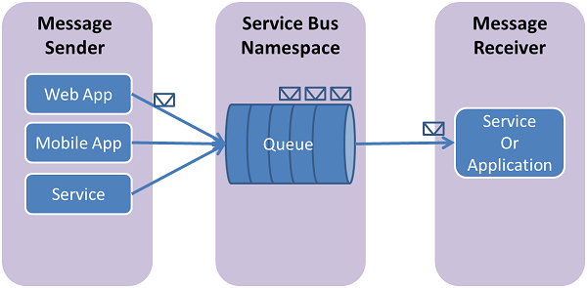
Service Bus Queues
Queues are used for async communication between components in distributed system.
Service Bus queues are a general-purpose technology that can be used for a wide variety of scenarios to communicate between:
components in distributed system
web and worker role in Azure app
general apps and Azure hosted apps in a hybrid solution
Notes:
Пример использования очередей -

Slide 9
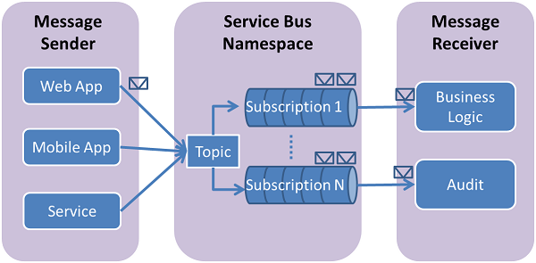
Service Bus Topics and Subscriptions
Topics and subscriptions provide a one-to-many form of communication.
When a message is sent to a topic, it is then made available to each subscription to handle/process independently.
Each subscription might optionally register filter rules to filter/restrict messages.
Each subscription is implemented as a queue and behaves like queue broker

Slide 10
Message Retrieving Modes
Receive And Delete
Messages are deleted from Service Bus once retrieved. Fastest way to retrieve messages.
Peek Lock
Messages are deleted after read confirmation only. Retrieved messages are not visible during lock timeout.

Slide 11
Service Bus API
Service Bus API - available as NuGet package
WCF integration
REST API

Slide 12
Service Bus Queue Messaging - Demo

Slide 13
Service Bus Topic Messaging - Demo

Slide 14
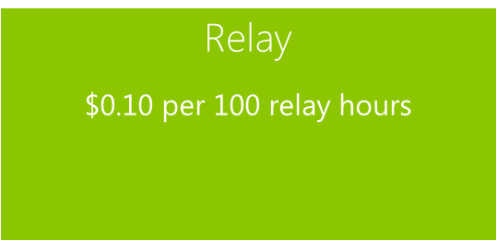
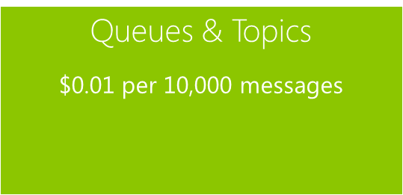
Service Bus Pricing

Slide 15

Questions?

Slide 16



Thank you!
Useful links:
1. Azure Service Bus documentation
2. How to use service bus queue in Azure
3. Using Service Bus Queue with WCF
4. Brokered vs Relayed messages
5. Introducing Queues and Topics in Azure Service Bus
6. ServiceBusExplorer download page
7. Sources and Materials
Valentine Radchuk
zaknafeyn@gmail.com
zzaknafeyn
Zaknafeyn

